Slide 1

Autonomous Driving Using Reinforcement Learning

Slide 2


Presenter
Data Scientist
Bachelor’s in Mathematics with a Minor in Computer Science from Hunter College, CUNY
Pursuing Masters in Applied Mathematics
United States Marine Corps Veteran and Air Force Reservist

Slide 3
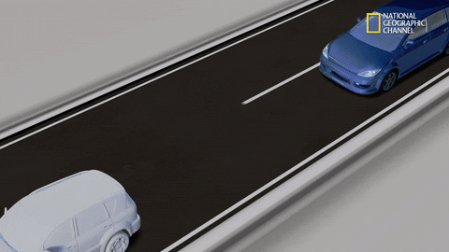
What is an Autonomous Vehicle?
An autonomous vehicle (AV) is a vehicle capable of sensing its environment and operating without human involvement.

Slide 4

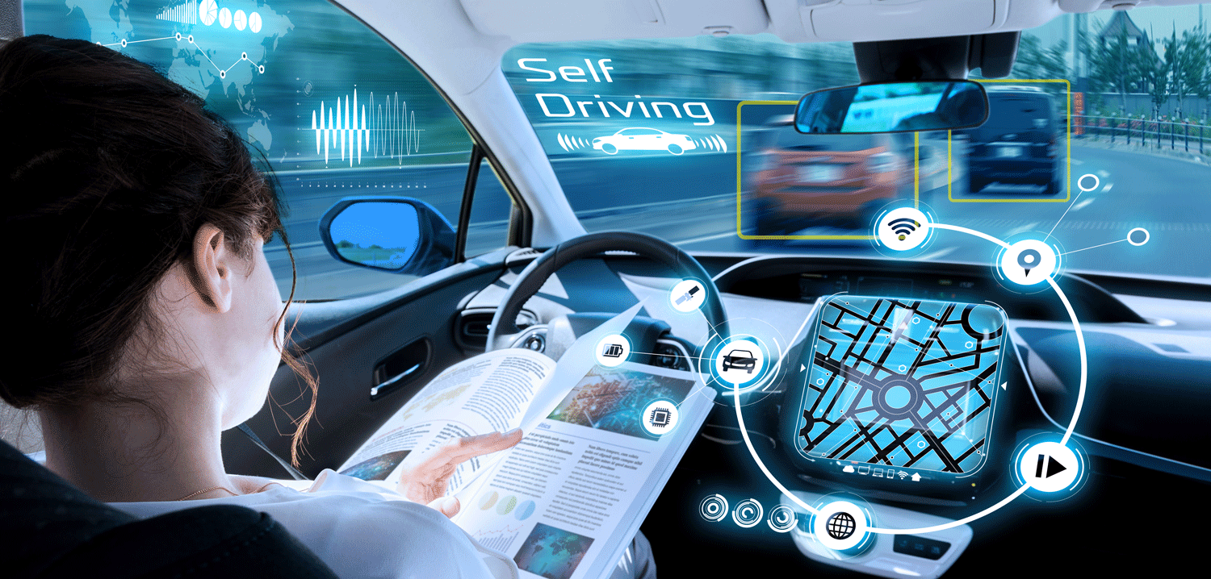
Why is Autonomous Driving Important?
Safer roads: Government data says that about 94% of car accidents are due to human error. Higher levels of autonomy have the potential to reduce risky and dangerous driver behaviors.
Accessibility for all: people with disabilities, such as the blind, will become capable of self-sufficiency, and highly automated vehicles(HAV’s) can help them live a better life.
More time: in a fully automated vehicle, all occupants could safely pursue more productive or entertaining activities, like responding to emails or watching a movie.

Slide 5
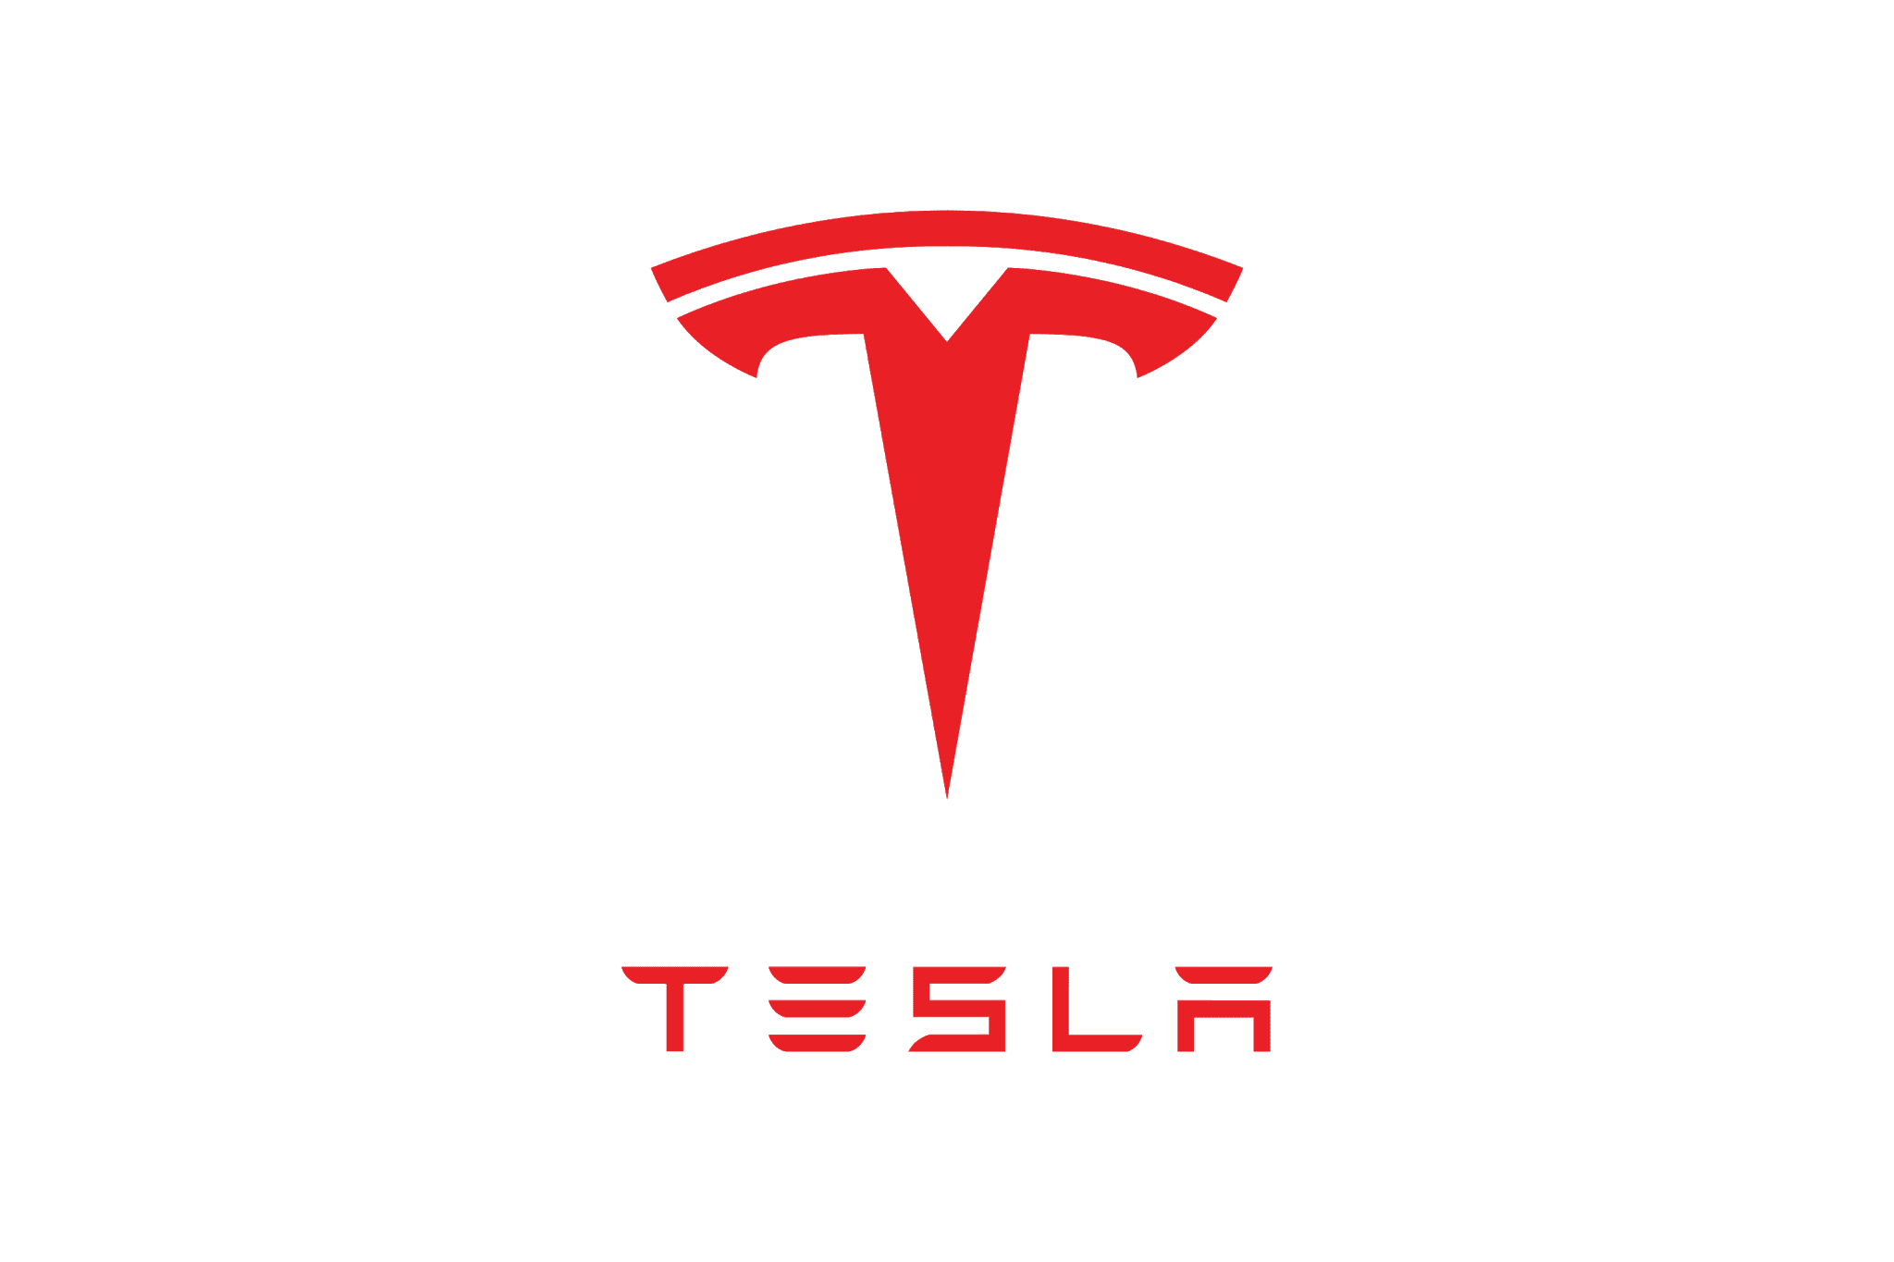
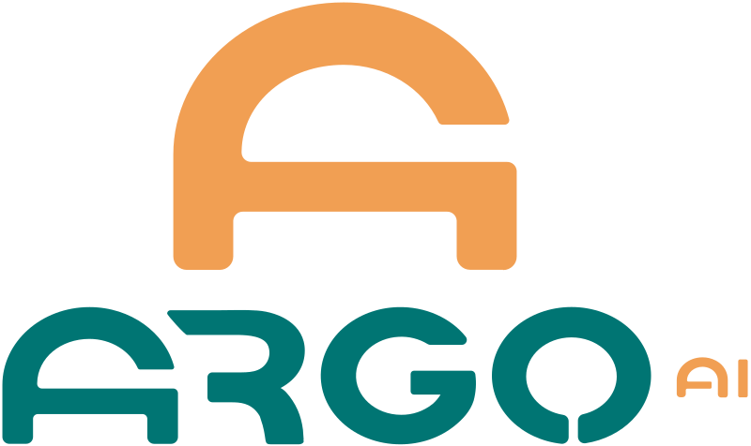


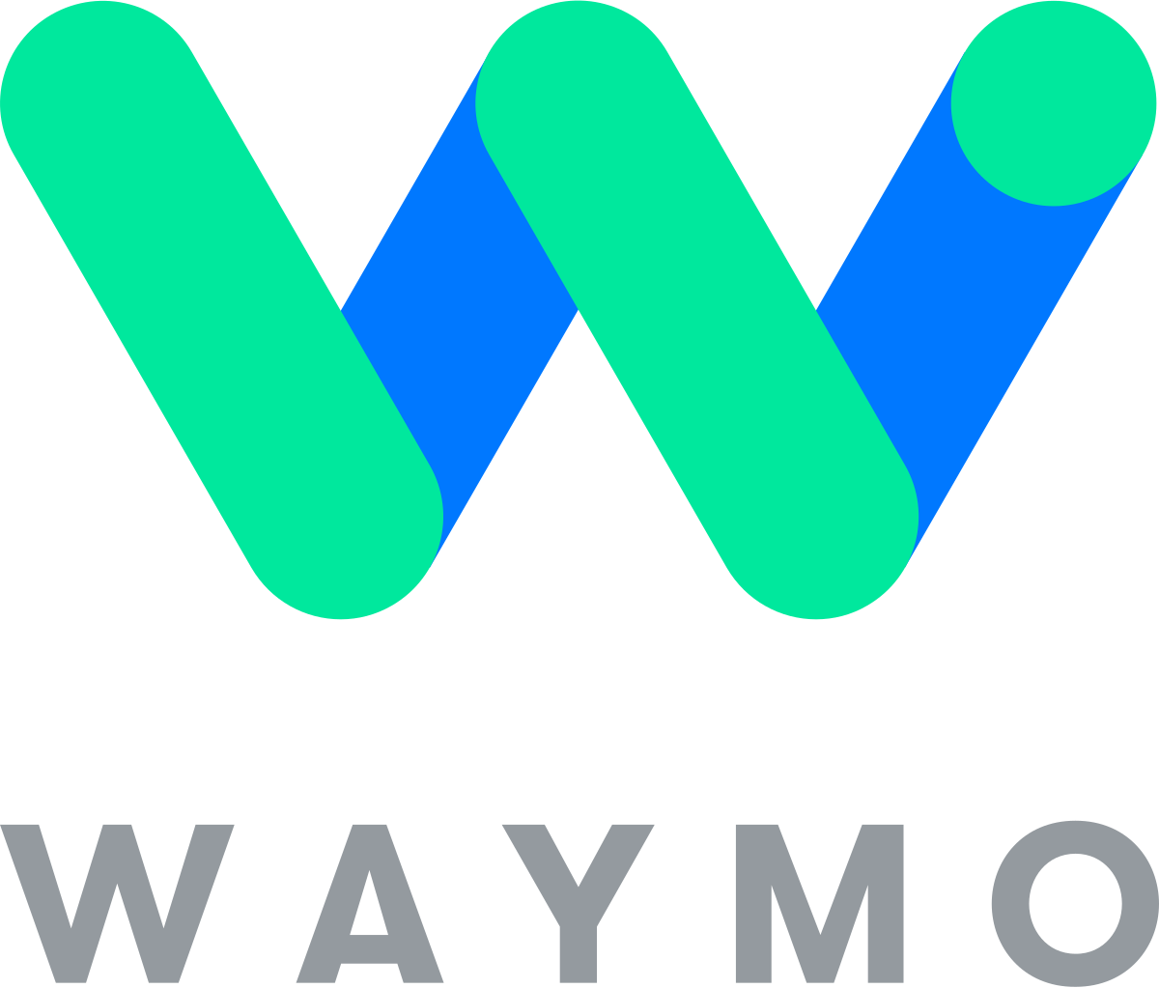
Who’s leading the race to Autonomous Driving?
There are many different companies working on autonomous driving software, however, according to analyticsinsight, the leading contenders are google’s Waymo project, Argo AI who is sponsored by Ford Motors, Tesla, General Motors, and China’s Baidu.

Slide 6
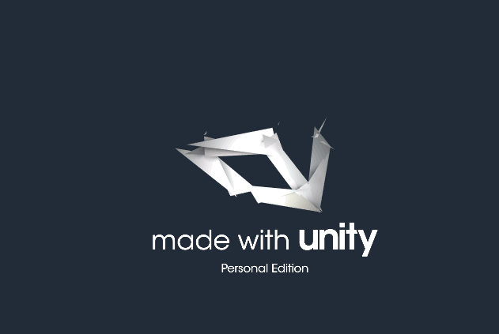
Set Up
Unity Engine: Unity Software Inc. is an American video game software company based in San Francisco.
ML-Agents API: The ML-Agents Python package contains 2 components:
A low level API which allows you to interact directly with a Unity Environment.
An entry point to train which allows you to train agents.

Slide 7
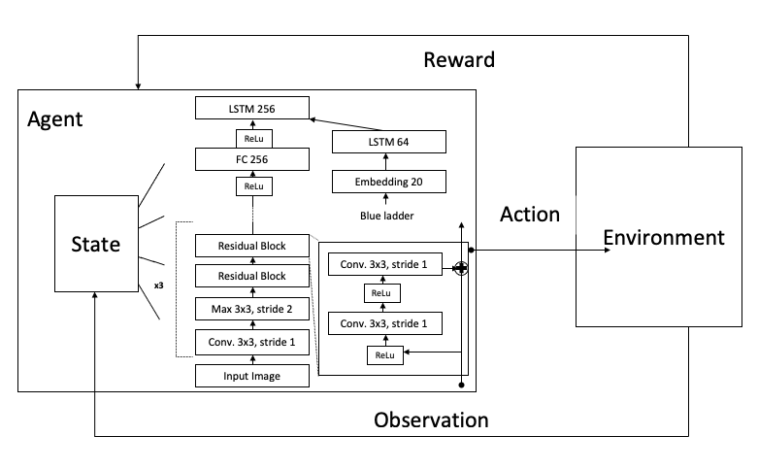
Reinforcement Learning

Slide 8
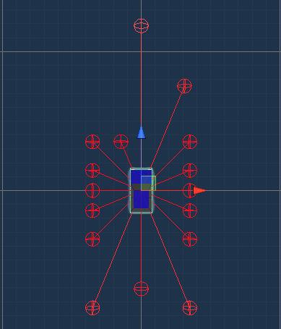
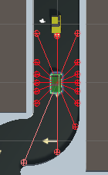
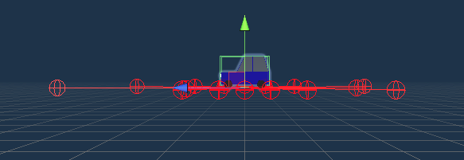
Agent
Ray Perception Sensors (LiDAR)
8 Rays per Direction
360° coverage
Ray Length of 20 Meters

Slide 9
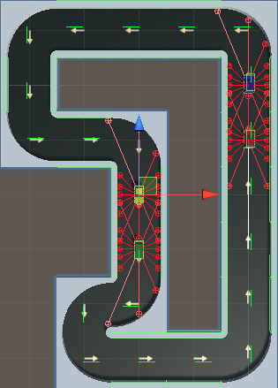
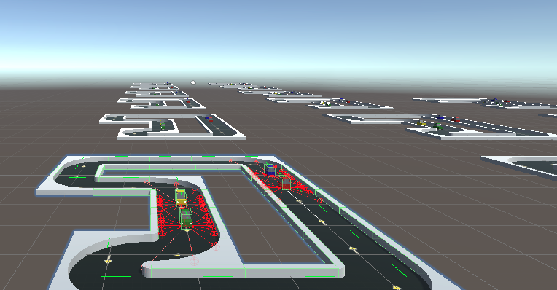
Training Environment
4 Agents per Training Instance (Track)
15 Training Instances

Slide 10
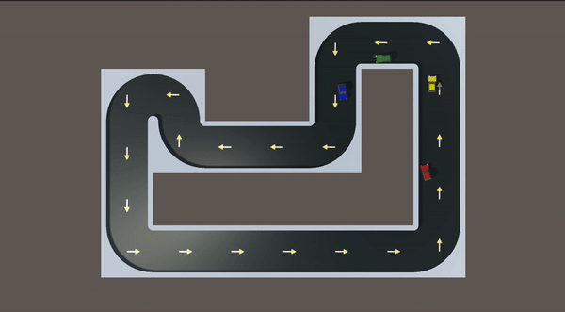
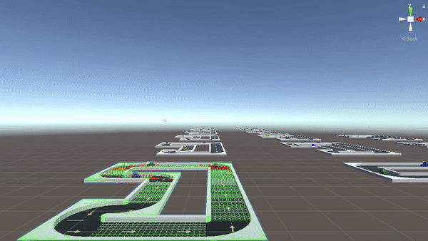
Training
5 Million Steps
15+ different combinations of Deep Reinforcement Learning algorithms and Neural Networks
Reinforcement Learning Algorithms:
Proximal Policy Optimization (PPO)
Soft Actor-Critic (SAC)
Neural Networks:
2 & 3 Layer Multilayer Perceptrons (MLP)
Convolutional Neural Network (CNN)
IMPALA Residual Neural Network (ResNet) with 3 Conv. Layers
Memory Enhanced Recurring Neural Network (RNN)

Slide 11
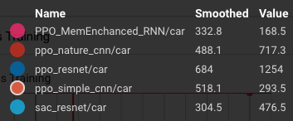
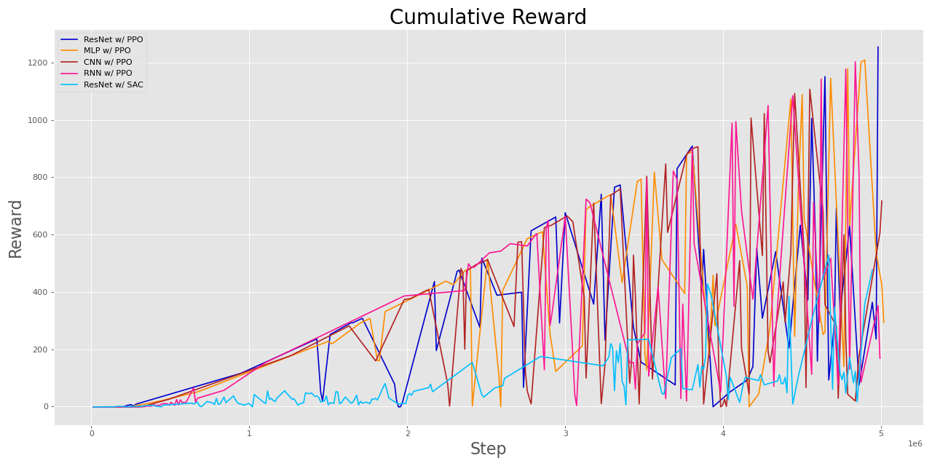
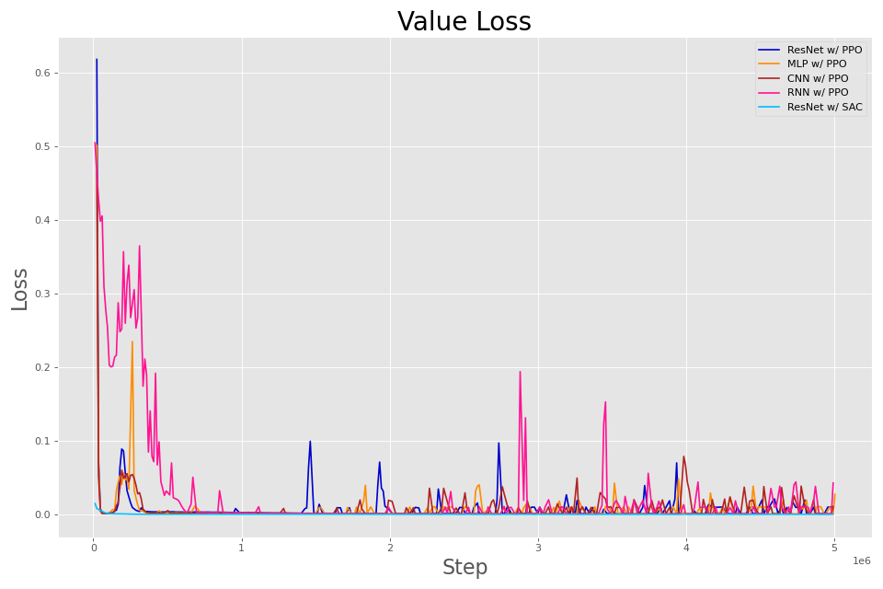
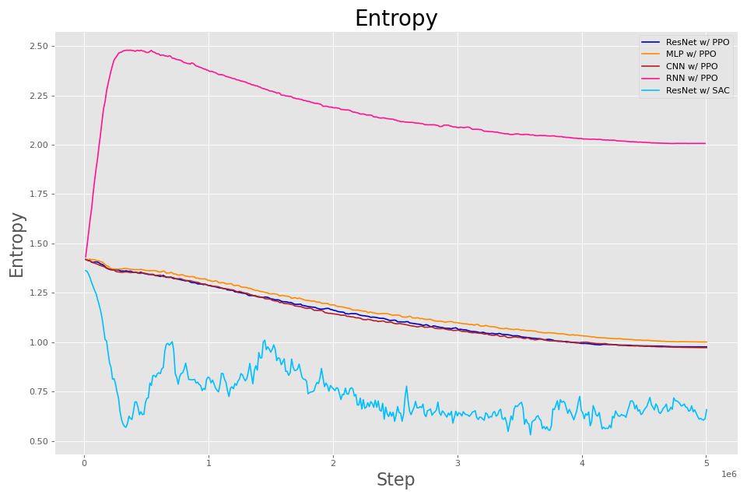
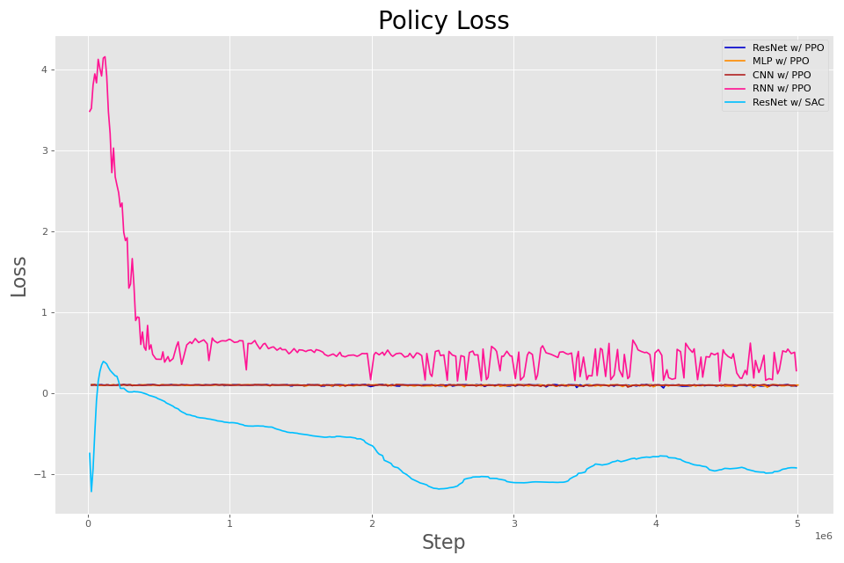
Training

Slide 12

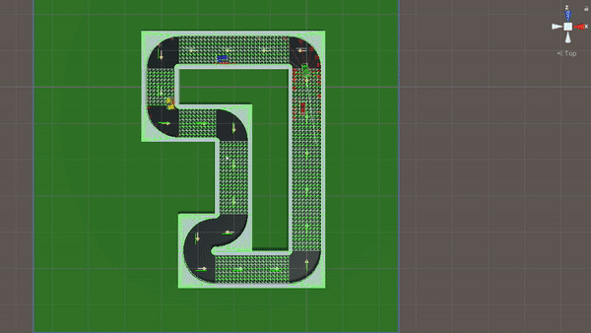
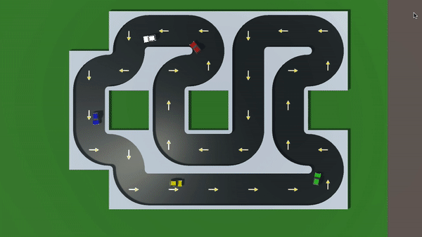
Testing Multiple Models Together
Performance:
IMPALA ResNet w/ PPO Algorithm Performed the Best
IMPALA ResNet w/ SAC Algorithm performed the worst

Slide 13
Conclusions
Reinforcement Learning Algorithm
Neural Network
For every single case, the PPO algorithm outperformed SAC algorithm
Overall IMPALA ResNet seemed to outperform the other combinations of Neural Networks and Reinforcement Learning Algorithms
Deduction
Combining the IMPALA ResNet w/ the PPO Algorithm is shown to outperform all other attempted combinations

Slide 14
Next Steps
Develop new and different style environments to train models on
Implement Object Detection component to the AVs
Environment
Computer Vision
Obstacles
More training!
Increase number of objects for vehicles to take into account when driving (i.e. people, traffic lights, etc.)
Apply more training time for models to become more and more accurate and safe

Slide 15
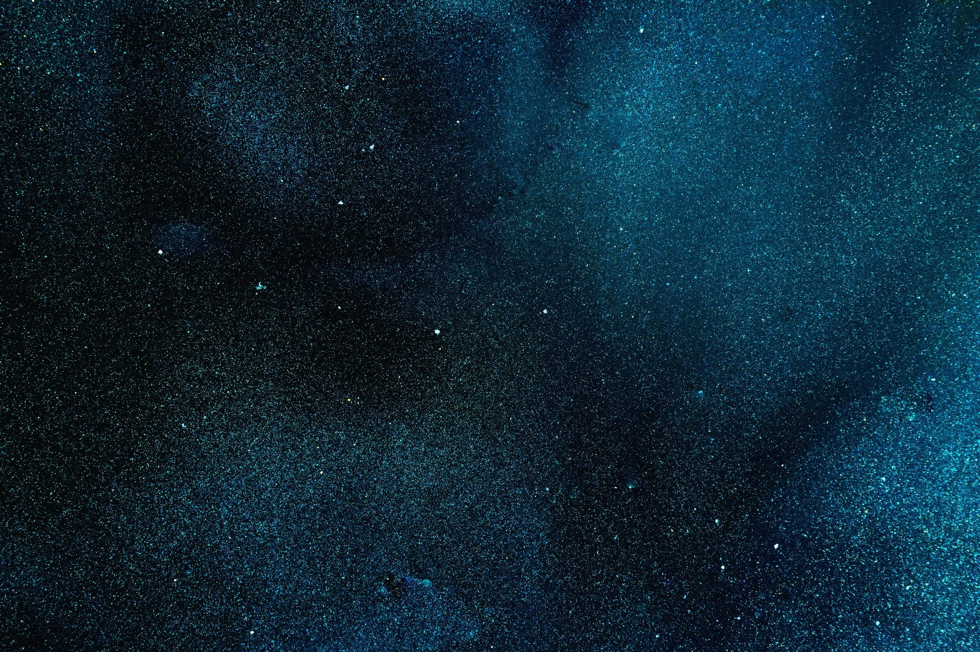
Thank You!
Are there any questions?
Presenter Information:
Thomas Joy II - Data Scientist
tomjjoy123@gmail.com
+1 (718) 869-9409
LinkedIn.com/in/thomas-joy-ii
GitHub.com/tomjjoy

